Slide 1
Air Force Employment Exercise (AFEX)
Notes:
1
Revised April 2022, OT Stephanie Lopez
Extra can take notes

Slide 2
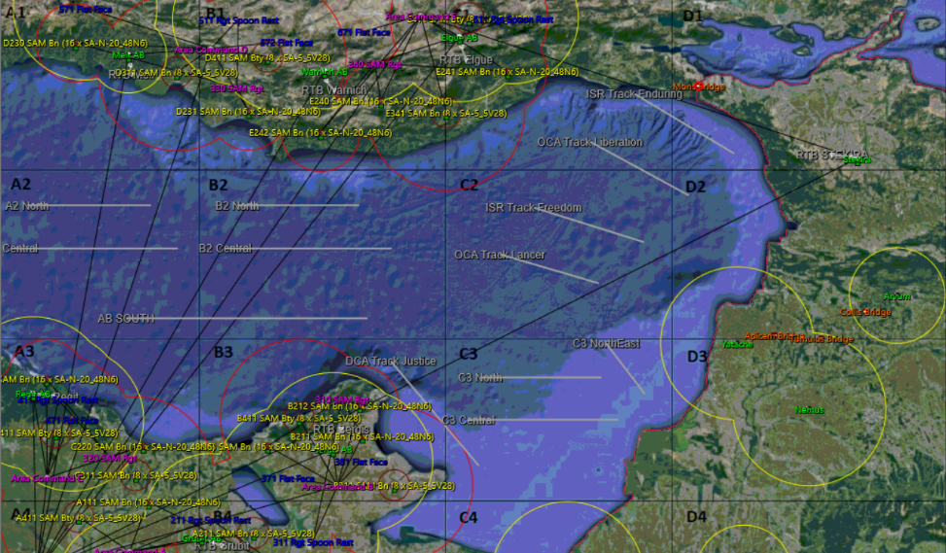
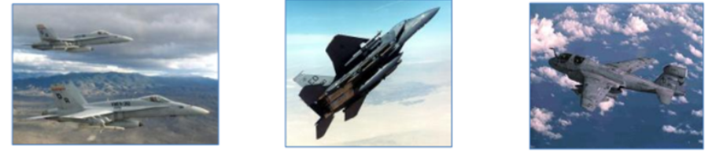
Overview
Purpose of Wargaming
AFEX Overview
Individual
Orientation
Mission Prep
Working as an AOC
Practice
Notes:
3
3
3
3
****REPLACE MAP!!!****

Slide 3
Purpose of Wargaming
• The Definition of a Wargame
- Simulation, by whatever means, of a past or hypothetical future military operation involving opposing forces and using rules, data, and procedures to depict a realistic situation
- Exercise that employs a live, thinking opponent (even if it’s a computer)
Notes:
11
11
11
11

Slide 4
Purpose of Wargaming
• Historical Examples of Wargaming
- Franco-Prussian War (1870-71): Prussia utilized the game Kriegspiel to train their officers
- WWII: Japanese planned the attack on Pearl Harbor and the Battle of Midway
- WWII: Germans used wargame analysis in an attempt to forecast where the Allies would invade
035017
Notes:
11
11
11
11

Slide 5
Purpose of Wargaming
• How the Air Force Uses Wargaming
- USAF Checkmate Planning cell used wargames to prepare contingency plans for ODS, OEF, and OIF
- RED FLAG at Nellis AFB improved our tactical capabilities using “Blue” vs. “Red” forces
- BLUE FLAG at Hurlburt Field improved the functionality of Air Operations Centers (AOC)
- Ulchi Freedom Guardian in the Republic of Korea
is a largely computer-based exercise used to improve our ability to defend the region
Notes:
11
11
11
11

Slide 6
Purpose of Wargaming
• Value of Wargaming
- Saves resources in times of fiscal constraint
- Provides lessons learned without necessarily
putting lives at risk in a combat mission
- Impacts doctrinal development (so we’re not counting solely on recent historical combat experience to shape our next strategy)
Notes:
11
11
11
11

Slide 7
AFEX Overview
• AFEX is one of several scenarios created with
Theater Airpower Visualization (TAV) software in the Modern Airpower suite of wargame applications
• TAV presents air power scenarios that are
hypothetical or based on historical events
– Gives players the means to plan an air campaign but also adjust their strategy in real time as the scenario plays out

Slide 8
AFEX Overview
• AFEX Purpose: Test players’ ability to
employ airpower against a computer opponent
with an unknown capability
– Force package
– Build and execute an air campaign
• Also …
– Demonstrate leadership, followership
– Work together as a team
– Problem solve

Slide 9
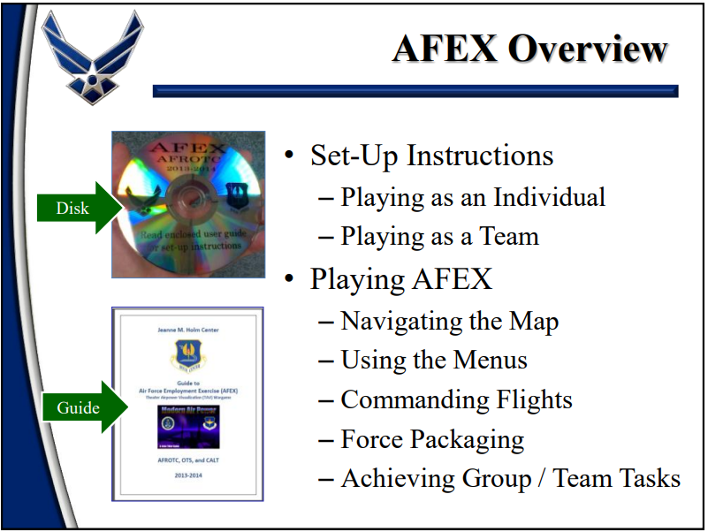

Slide 10
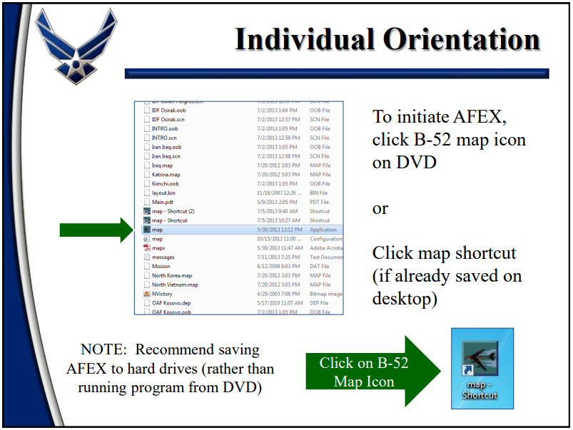

Slide 11
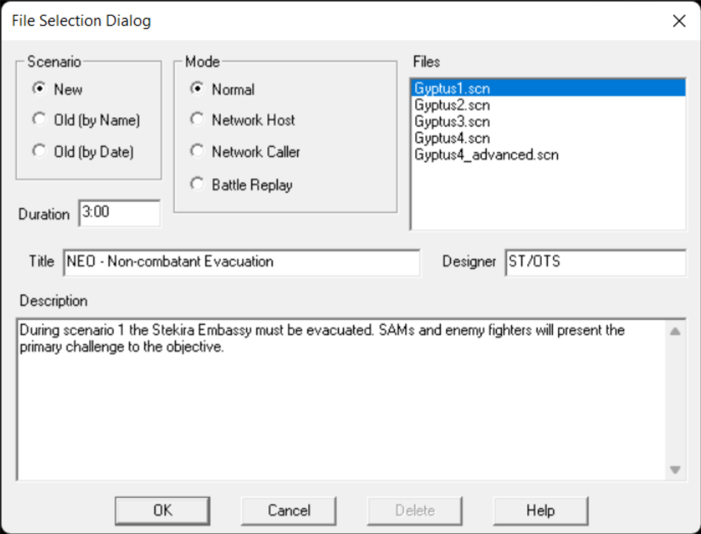
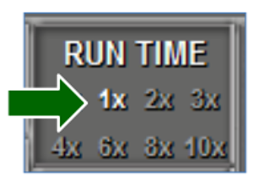
Individual Orientation
Select Network Host or Network Caller depending on your position
Highlight “Gyptus#.scn” as appropriate
Click OK
You may run AFEX at any speed as an Individual (1x is real time).

Slide 12
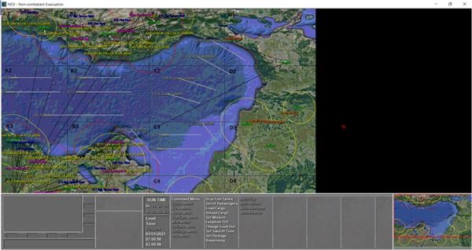
Individual Orientation
Main Chart
To navigate the map, use four zoom levels.
These may be toggled using the 1, 2, 3, & 4 keys or zoomed in and out using your mouse’s scroll wheel
Jump Chart
Also … Click anywhere on the jump chart to instantly move to a desired location on the main chart.

Slide 13
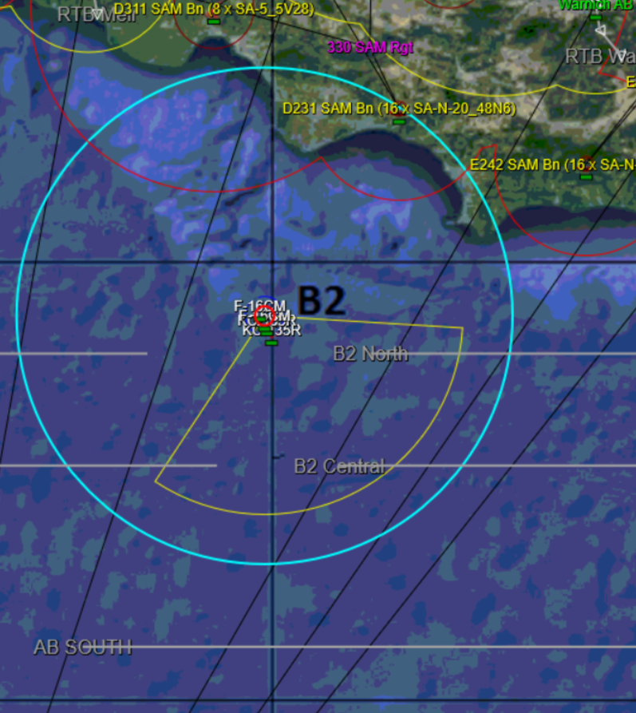
Individual Orientation
Left-Click on an aircraft to reveal range indicators …
Common range indicators:
  Yellow = Range of on-board radar
  Red = Range of on-board ordnance
  Blue = Current range of visibility
Left Click

Slide 14
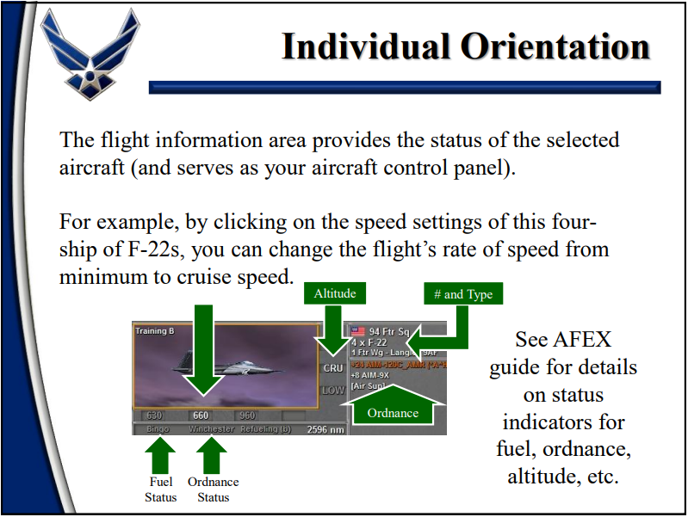
Individual Orientation

Slide 16
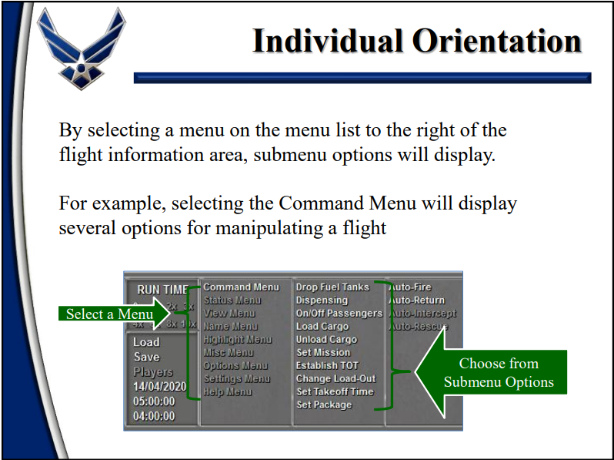

Slide 17
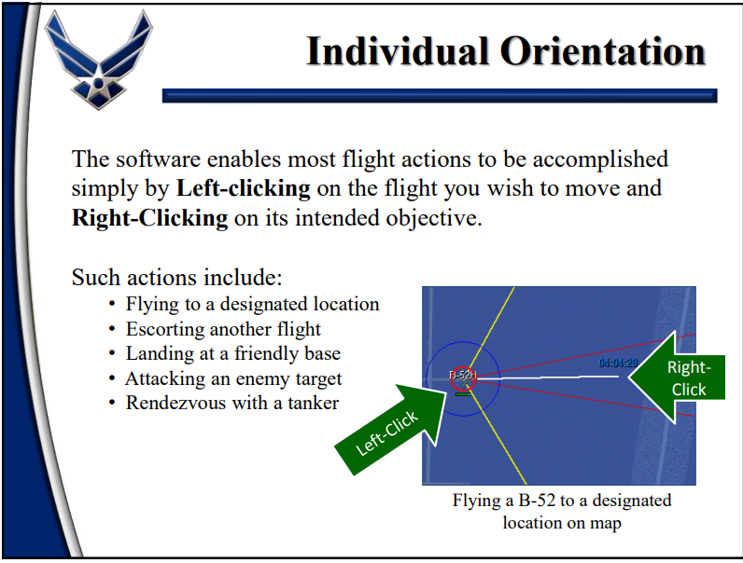

Slide 18
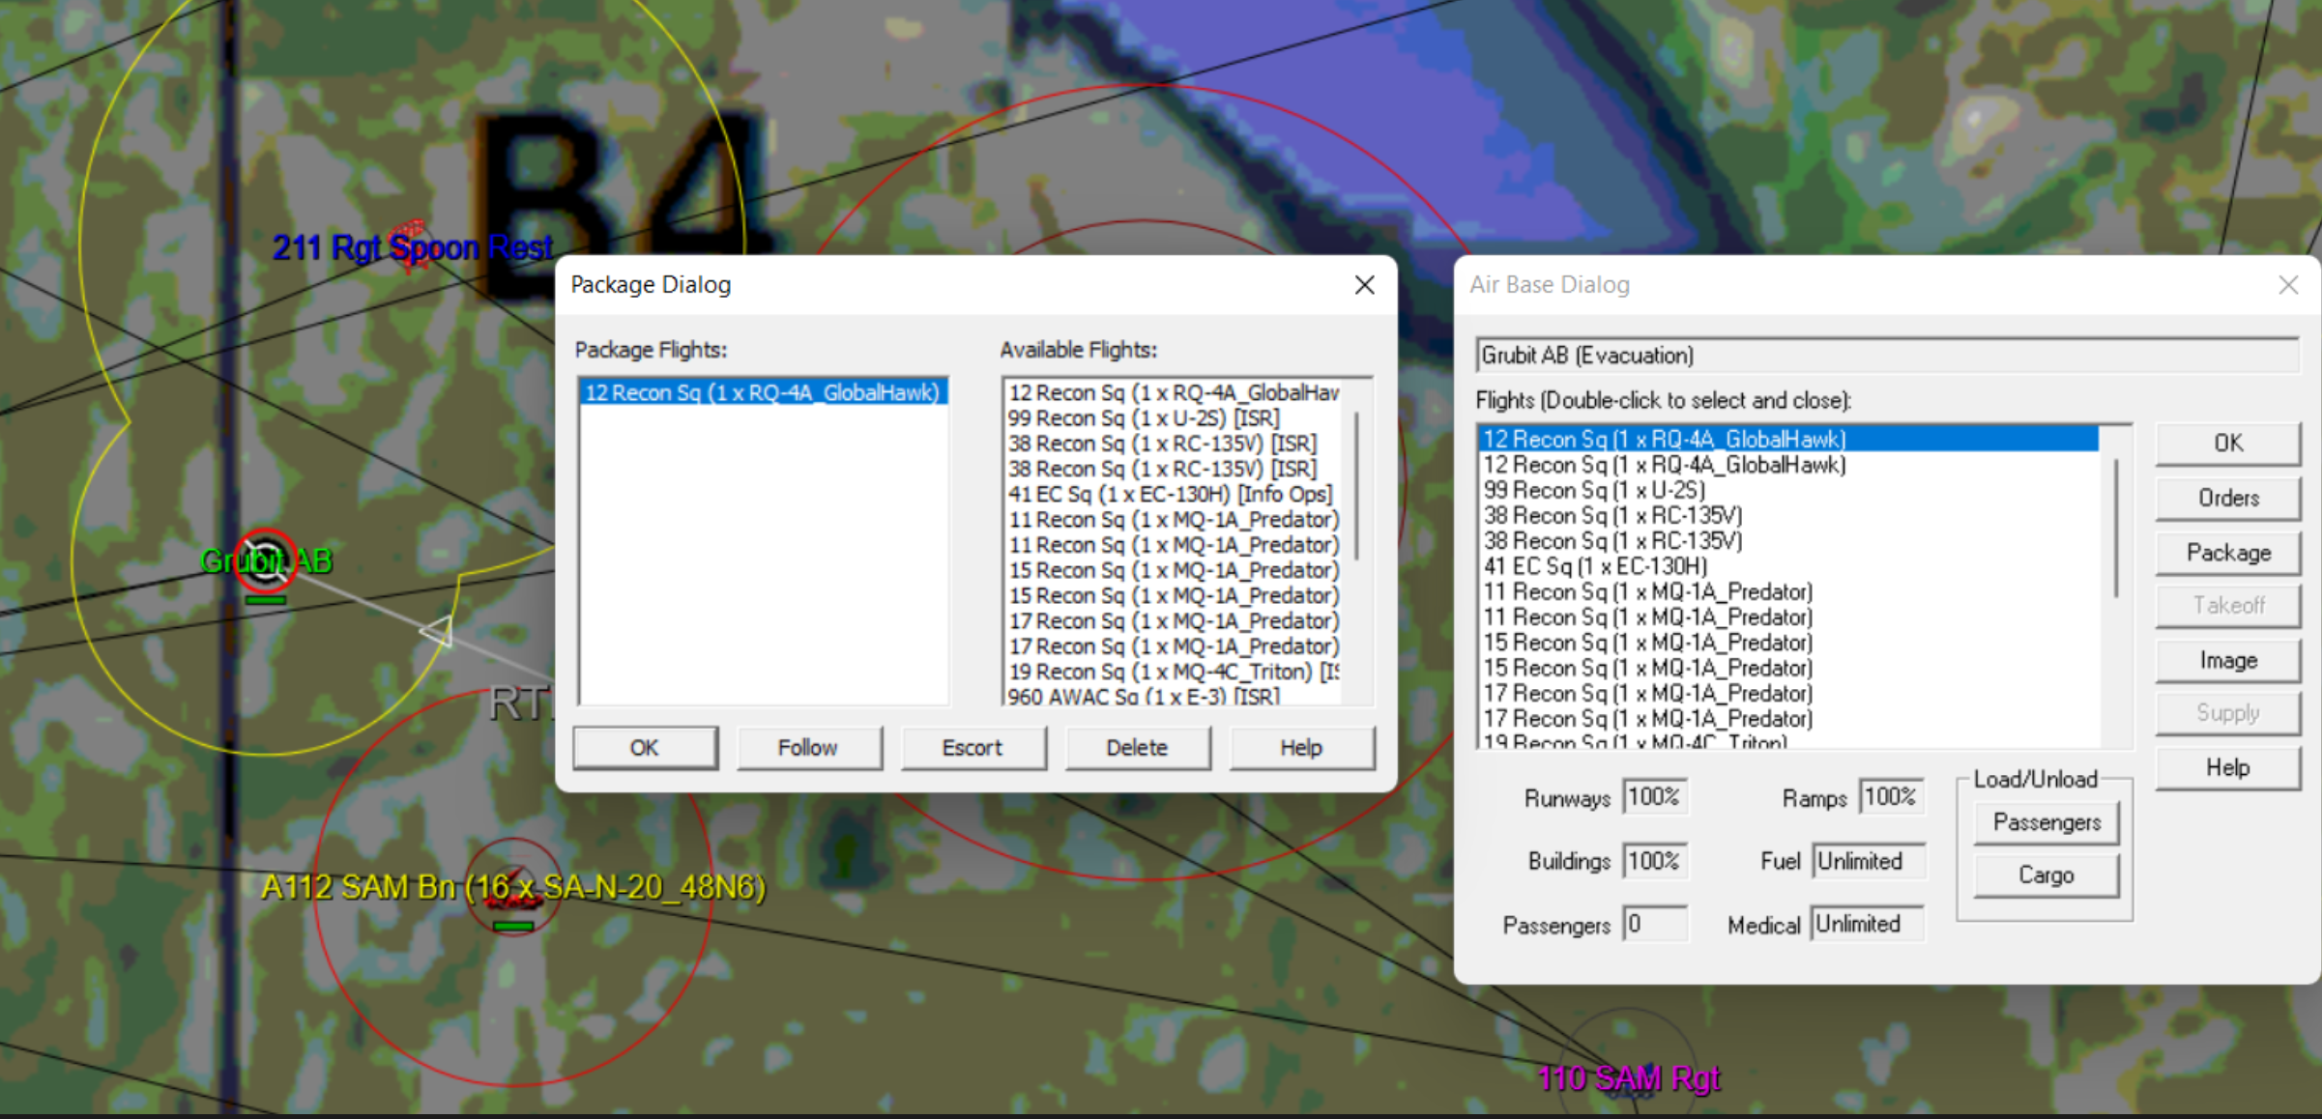
Individual Orientation
By Double Left-Clicking on a friendly air base, you’ll reveal an Air Base Dialog that lists assets parked at the base.
Select air base
Package
Double Left-Click
You may then force package aircraft and assign orders using the orders button to select a flight track or path for the lead aircraft – or you may simply right-click on the desired destination on the map

Slide 19
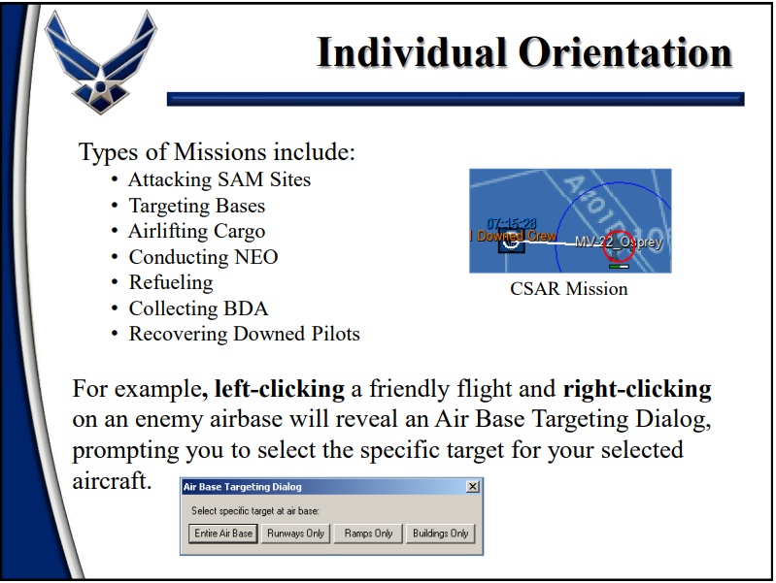
Individual Orientation

Slide 20
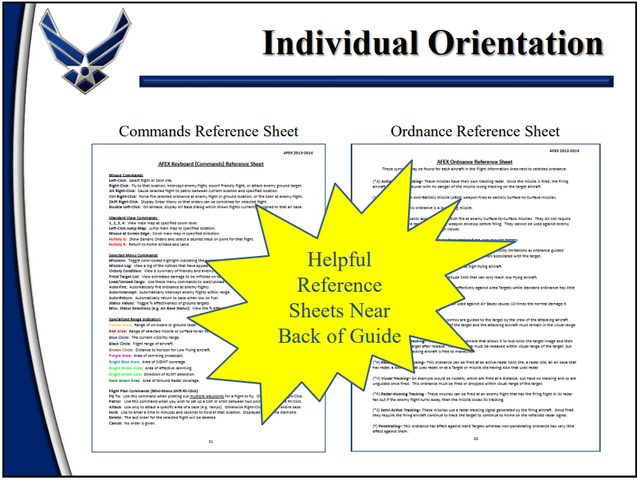

Slide 21
Mission Prep
AFEX Situation Update
  The United States currently has 600 noncombatants in Hyperion at the Stekira Air Base
  All noncombatant personnel at Stekira AB must be evacuated to Warnich AB
Commander’s Mission Statement
  The safety of U.S. noncombatant personnel at Stekira Air Base (AB) and the civilian population of Hyperion must be maintained.

Slide 22
Mission Prep
Specified Functional Tasks
  1. Gain & Maintain Air Superiority
  2. Conduct & Support Counteroffensive
  3. Degrade Enemy Conventional
  Military Power
  4. Prevent Air or Missile Attacks
  5. Conduct NEO Evacuations
  6. Resupply Forward Operating Bases
  7. Coordinate & Assist in the Recovery of Downed Crews

Slide 23
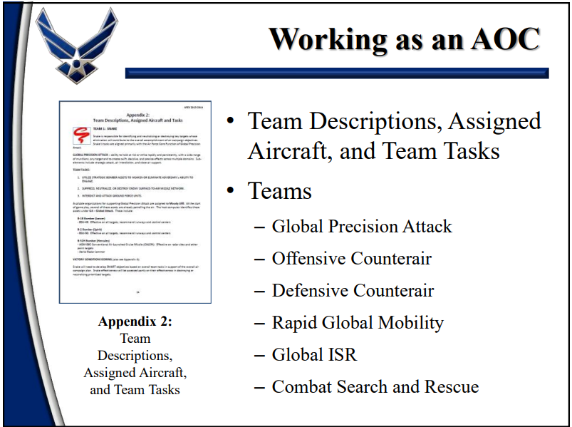
Notes:
Air Operations Center
ISR=intelligence, surveillance, reconaissance

Slide 24
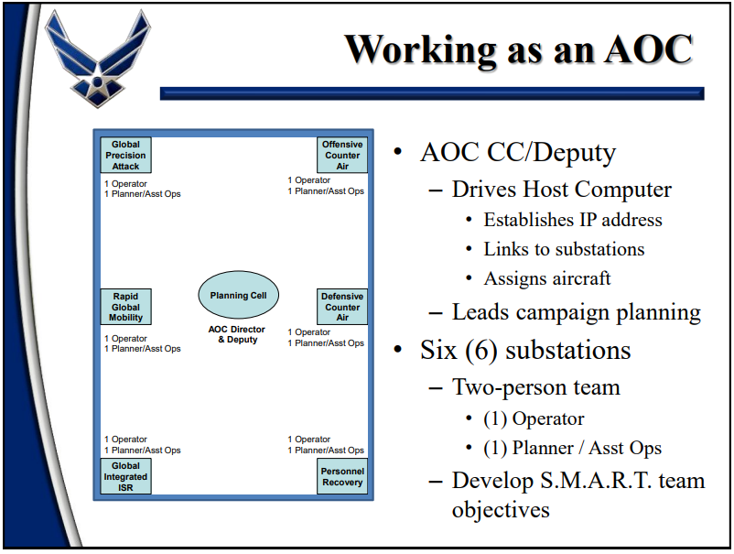

Slide 25
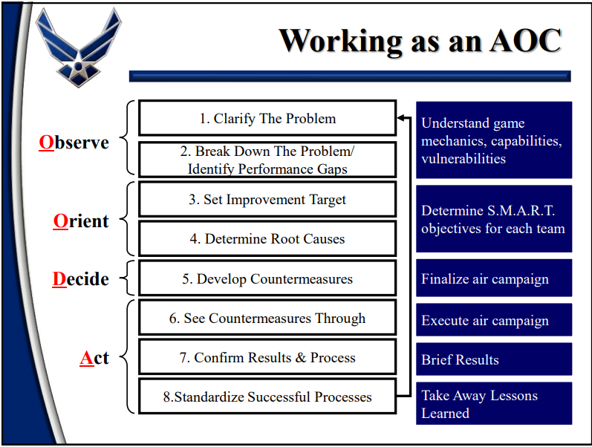

Slide 26
Summary
Purpose of Wargaming
AFEX Overview
Individual
Orientation
Mission Prep
Working as an AOC
Practice
Notes:
3
3
3
3

